Slide 1
Clustering-Based Inference for Biomedical Entity Linking
NAACL_2021

Slide 2
The Problem with existing solution
One technique uncommon in BEL that deserves more attention is clustering.
This approach works well when mentions may be difficult to link directly to their ground truth entity, but may have very clear coreference relationships to other mentions.
Most SOTA do not record interaction between intra document mentions , which are similar in nature based on some similarity measure.

Slide 3
_
Recent Encoder based model utilize training which are discussed previously are some such examples.
Although they take context to learn but do not work on intra document mention interaction
To summarize with recent papers discussed
Dual encoder based model , paper using LATTE –
So , for both ,zero shot learning or for ambiguous surface mentions this approach should , in theory work well.

Slide 4
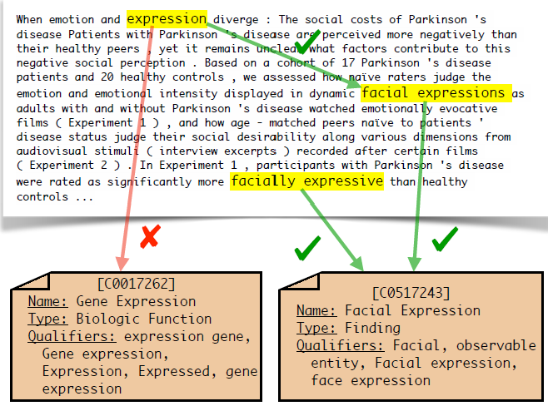
An Example

Slide 5
Overview of proposed solution
This model builds a graph where
Nodes - union of all of the mentions and entities and
Edges - have weights denoting the affinities between the endpoints.
Each cluster has must have one single entity. Mentions are either directly linked or join a cluster for linking to be done.

Slide 6
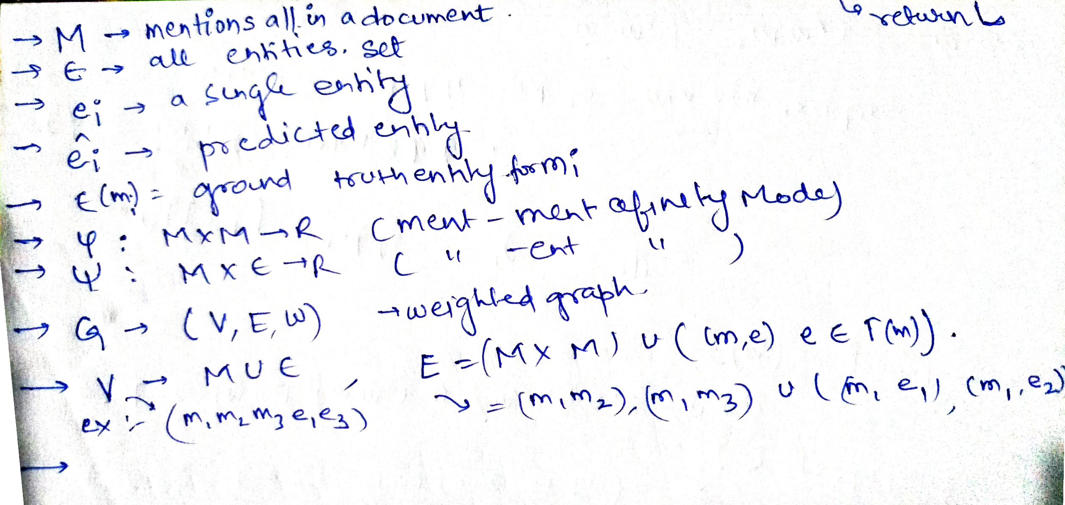
General Symbols

Slide 7

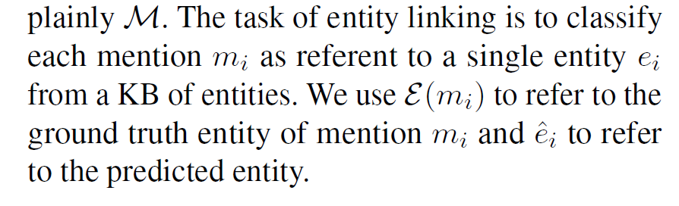
Some notations

Slide 8


Notations
are the functions to calculate affinitiy score between nodes.
Graph G is given as
is candidate set for mention.

Slide 9
Model Overview
Affinity here is defined as the score of similarity between two nodes of graph.
When every cluster contains one entity this process terminate. Initial state is one mention per cluster.
There are two trainable models for affinity calc. inititallized with embeddings from BioBert.

Slide 10
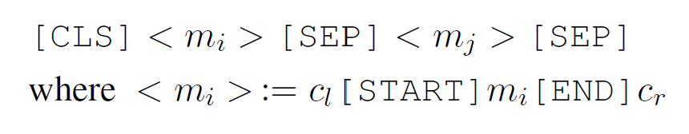
Mention-Mention Model
Is a cross encoder taking input as a pair of mention in context and producing a single scalar affinity for every pair.A
The affinity for a mention pair is computed by concatenating their mention representations(embeddings?) and passing it through a linear layer with a sigmoid activation.

Slide 11
Training
Uses a variant of the maximum spanning tree (MST) supervised single linkage clustering algorithm presented in Yadav et al. (2019).
Mention-Ment model runs an algorithm to perform clustering based on scores generated by a trainable model.
The objective is to minimize the following loss triplet max-margin with margin mu for each cluster C*

Slide 12
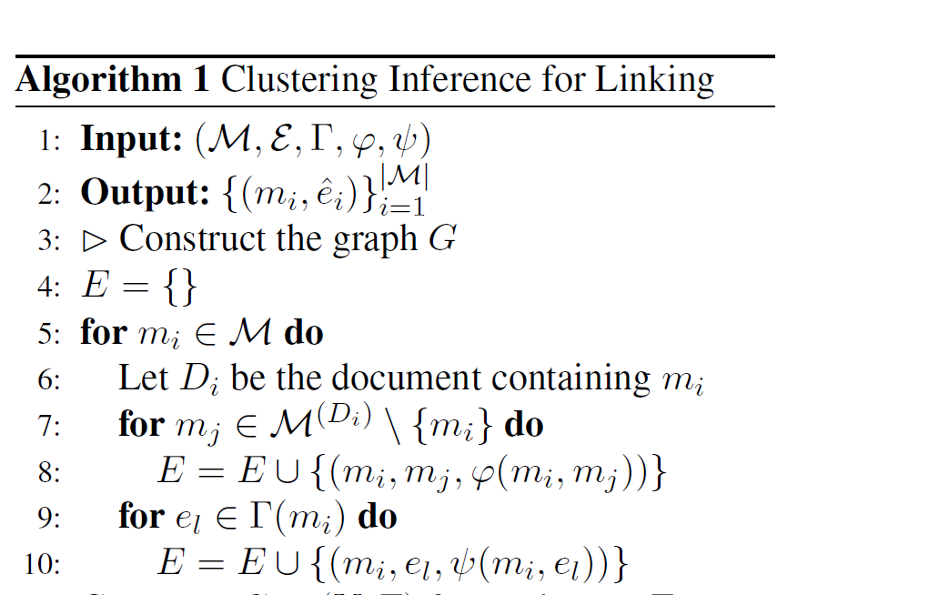
Training process of Clustering Algorithm

Slide 13
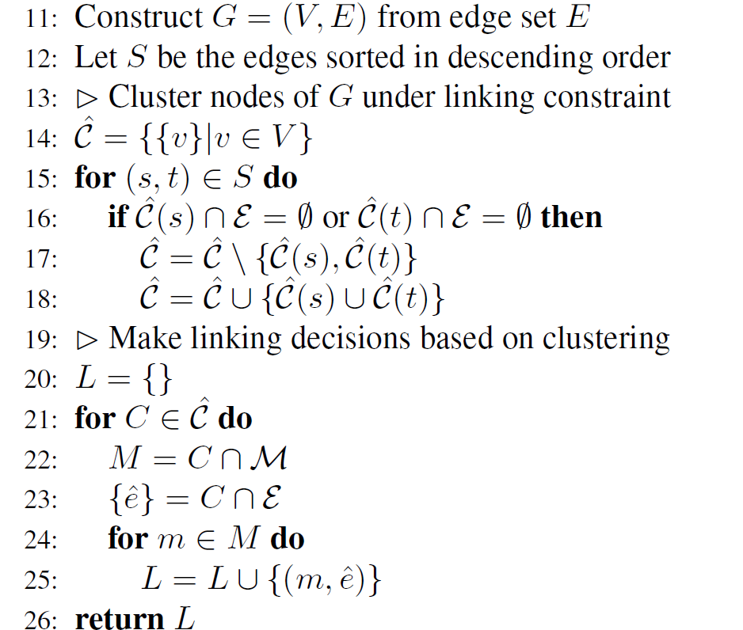
_(a-b)

Slide 14
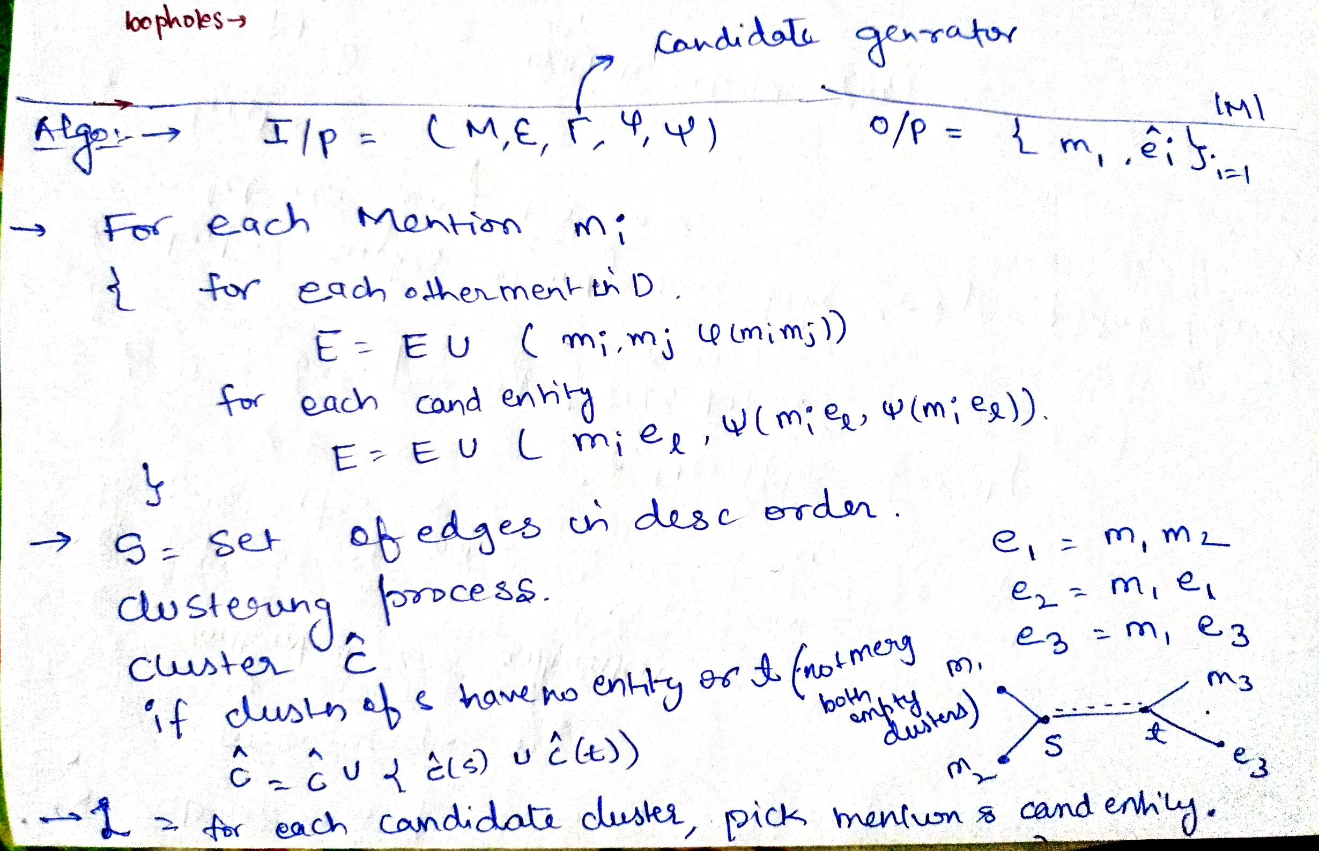
Algorithm

Slide 15
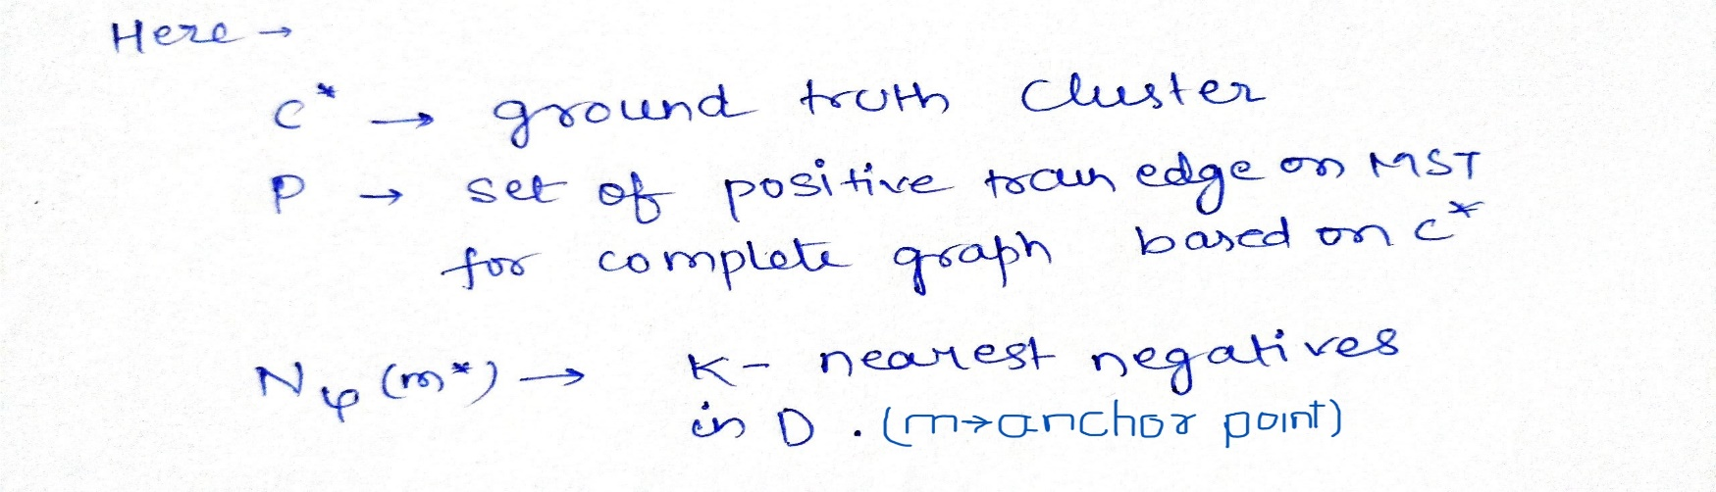
Notation for loss function terms
The objective of loss function is to , is to keep those negatives which are closest from ground truth only.
for each anchor point and positive edge node pair , sum over diff between all negative candidates affinity with anchor and pos with anchor and minimize this sum .(assumption).positive here is ground truth .

Slide 16
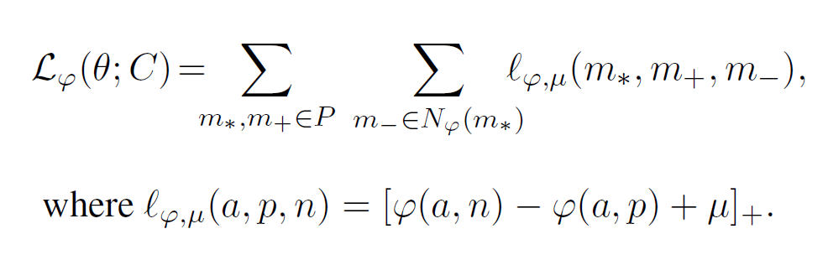
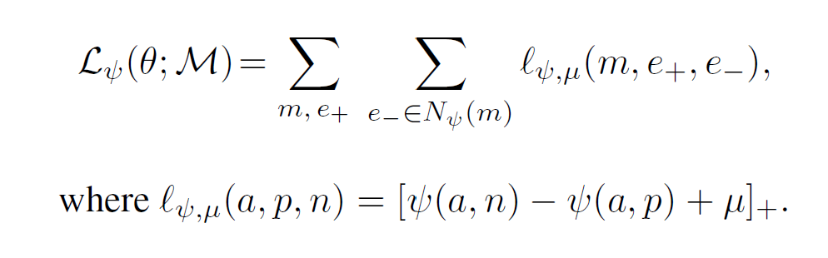
Loss Functions for the affinity models
For each cluster C belonging to C* (true) minimize :
Similarly for mention entity model training objective is to minimize:

Slide 17
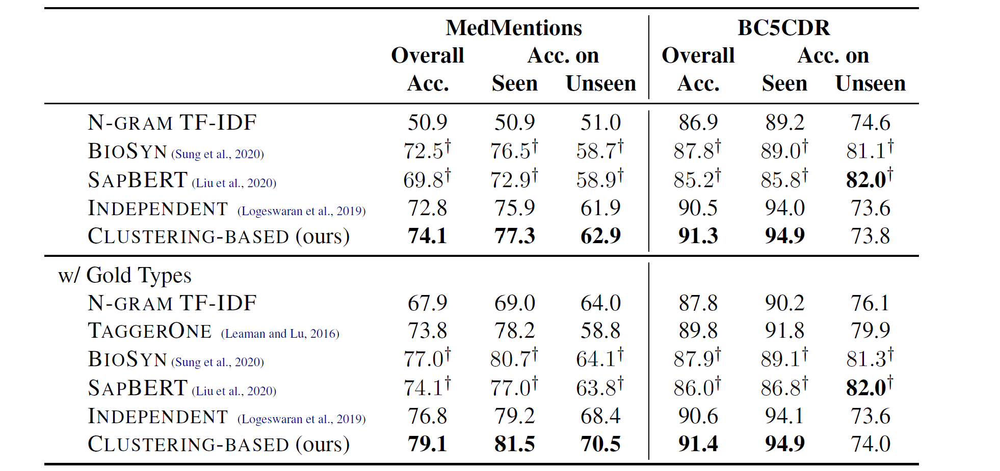
Results
D

Slide 18
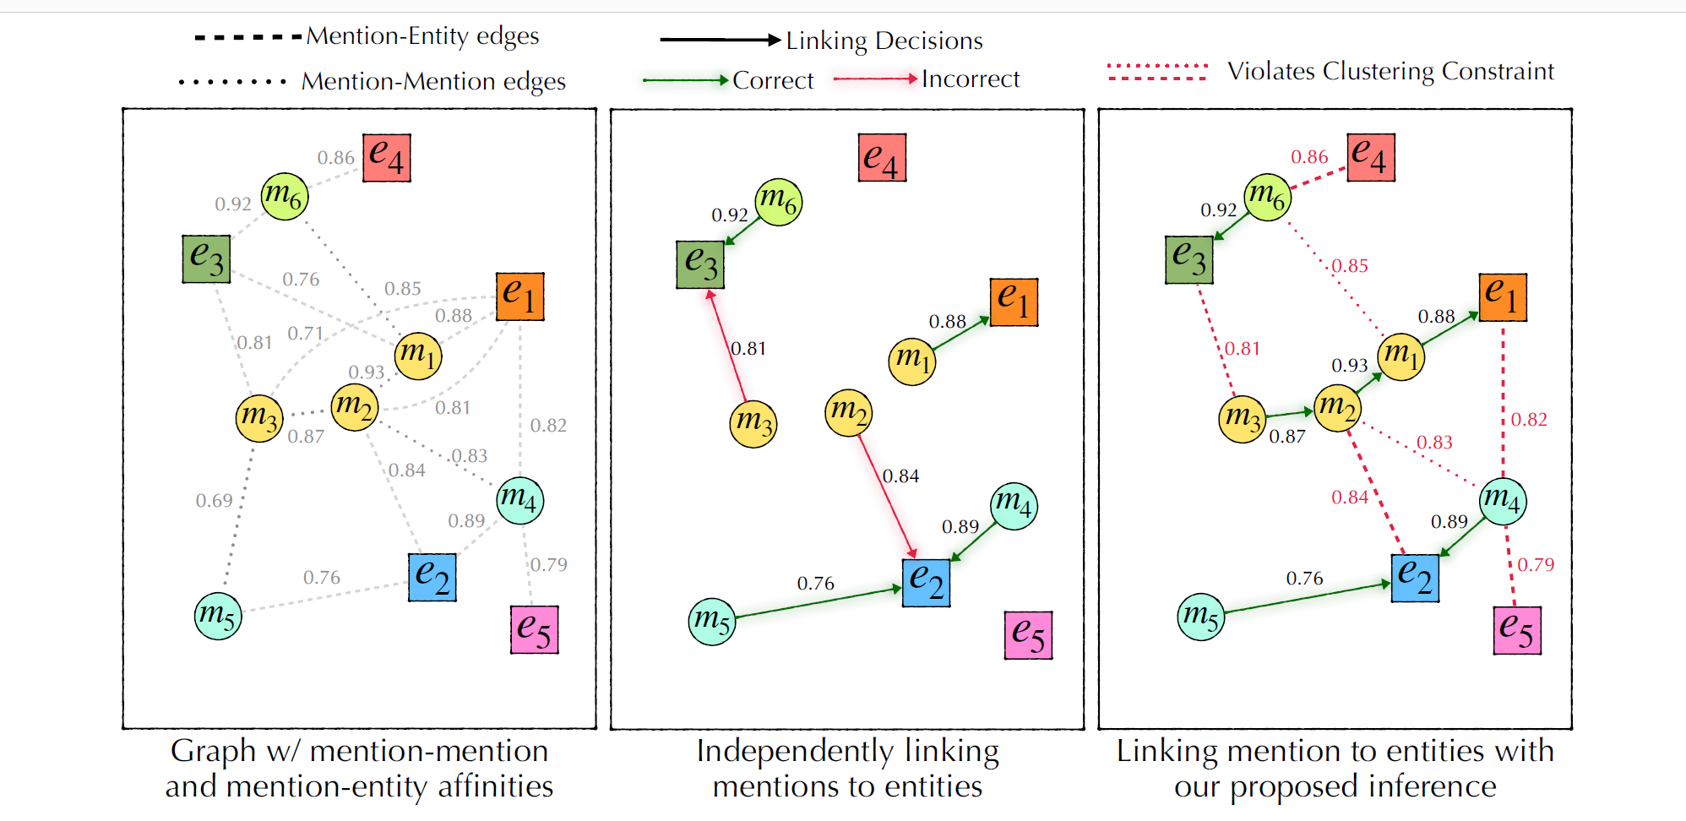
Observations
MedMention and BC5DR datasets used.
For this linking example m3 correctly links to it gold target e1 instead of e3 although the affinity scores are w(m3,e1)>w(m3,e3)

Slide 19
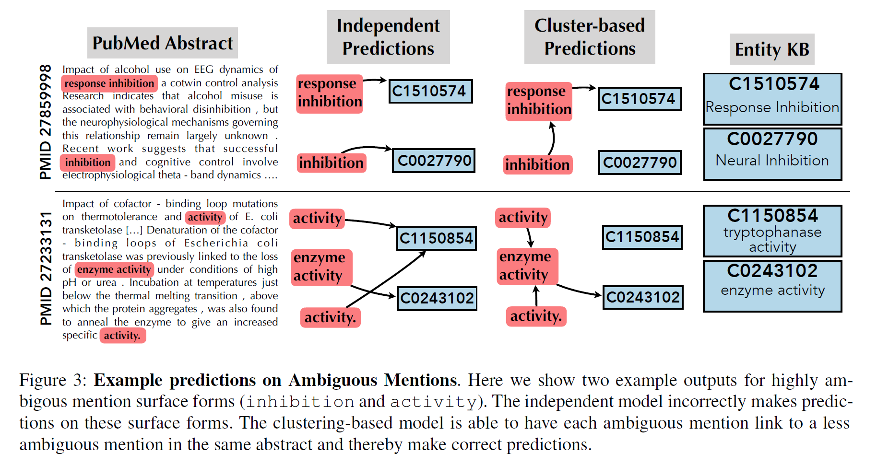
example
Mention-mention relationships are also explored in some previous works also. These works use attention in a way to build the context representation of the mentions. However, as mentioned by Logeswaran et al. (2019) is not well suited for zero-shot linking.

Slide 20
Observation
Due to TAGGERONE’s joint entity recognition , for comparison to be fair gold entity results are also passed to each of the model and result is reported.
While the performance of the independent model is upper bounded by the recall of candidate generation, this is not an upper bound for the clustering-based model.
The clustering-based model can allow mentions that have no suitable candidates to link to other mentions in the same document.

Slide 21
Candidate generation
N-gram TFIDF model to produce candidates
The candidate generator utilizes the 200k most frequent character-n-grams, and the 200k most frequent words in the names in E to produce sparse vectors for all E of the mentions and entity descriptions.
We show through analysis that our approach is better suited to link mentions with ambiguous surface forms and link mentions where the ground truth entity is not in the candidate set.

Slide 22
Limitation/ambiguties
What if node matches randomly wrongly with entity with high score.
How this model is effective for zero shot learning .
About gold target insertion and candidate generation .
How model will handle ambiguity and zero shot learning in theory.
The ambiguity , high score attachment with prerelevance entity should be overcomed by score within the similar mentions.
Small information is available or ambiguity is there in linking.

